Slide 1


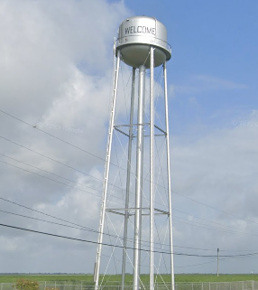

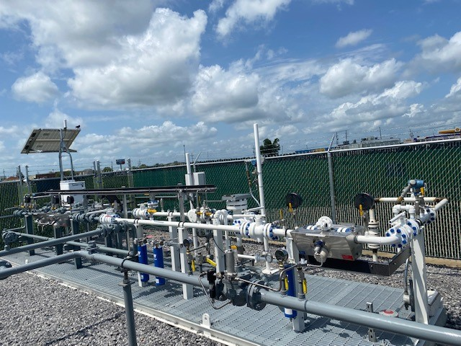
St. James Parish Utilities Infrastructure/Assets

Slide 2

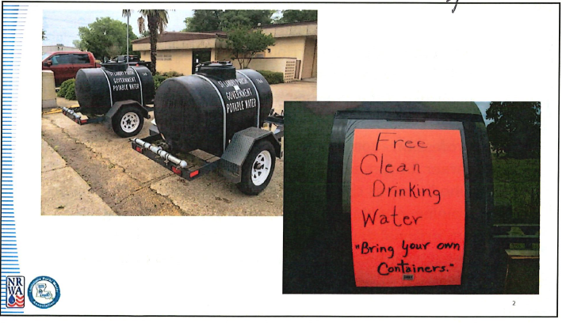

Slide 3

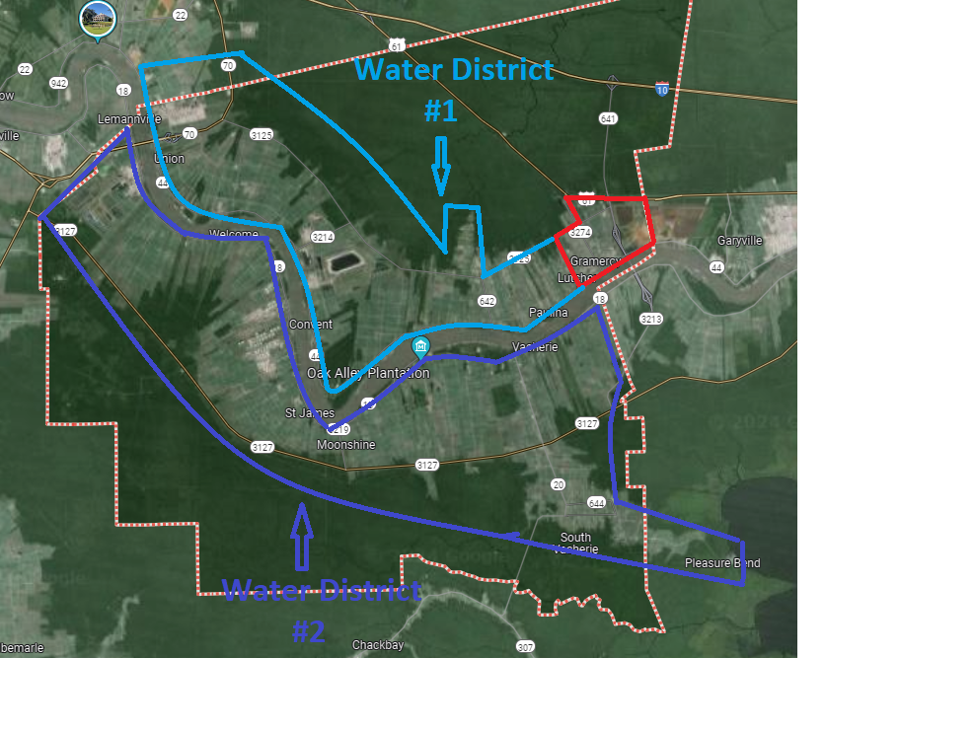
Water Assets
Water District #1 & 2

Slide 4
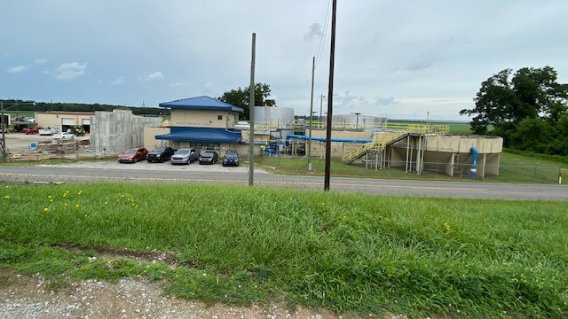
Convent Water Plant
Constructed in 1954

Slide 5
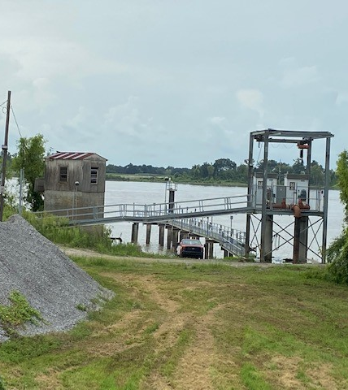
Convent Water Plant River Pumps
Installed in 2018

Slide 6

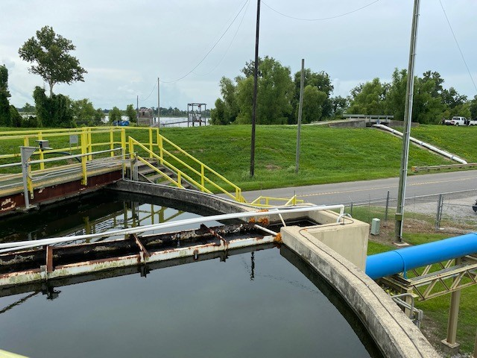
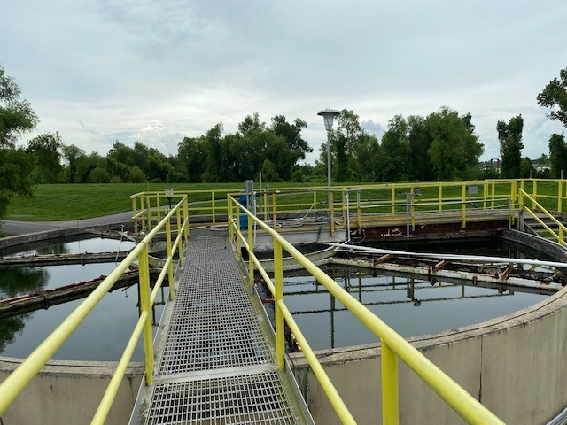
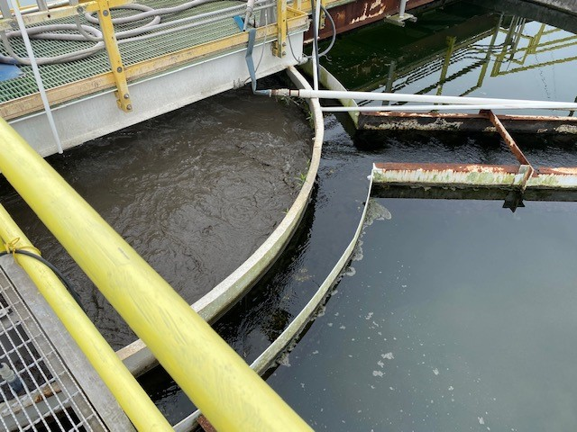
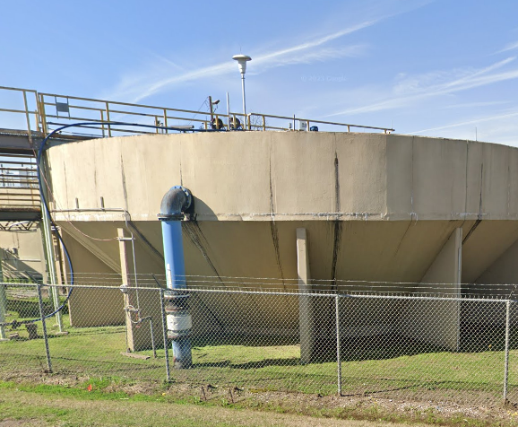
Convent Water Plant Clarifier
Constructed in 2003 For $650,000

Slide 7
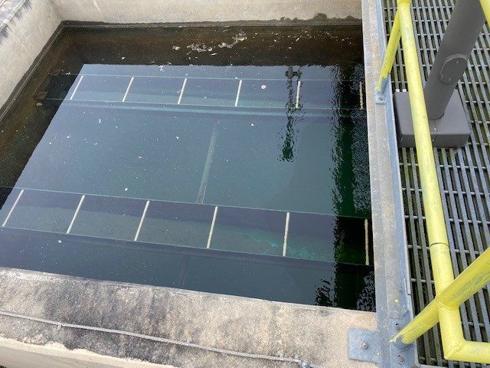
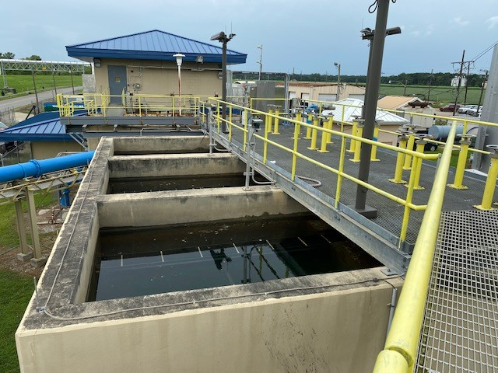
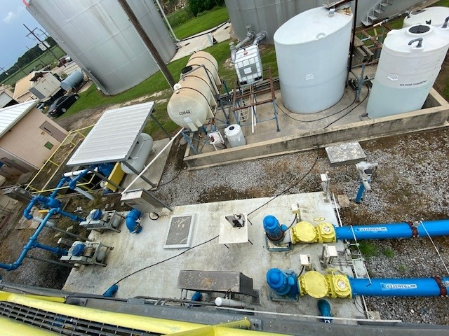
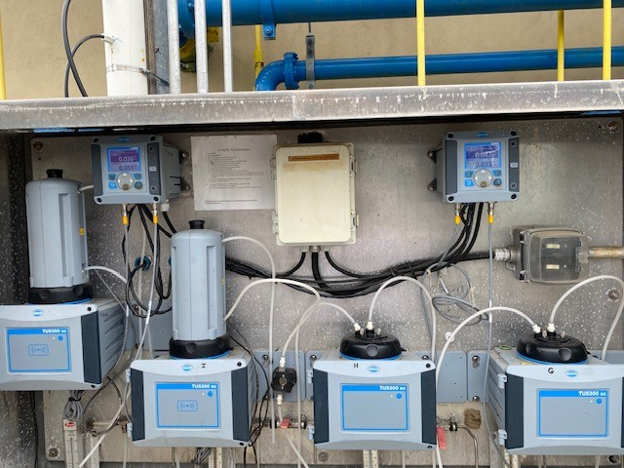
Convent Water Plant Filters
Constructed in 2012

Slide 8
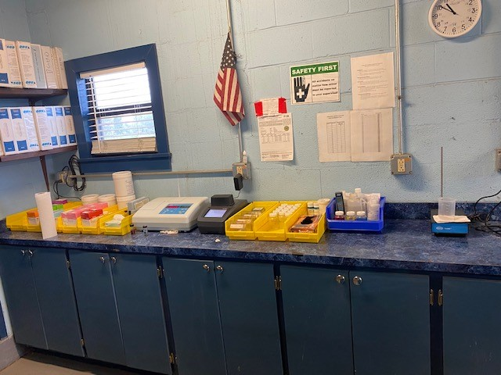
Convent Water Plant Lab

Slide 9
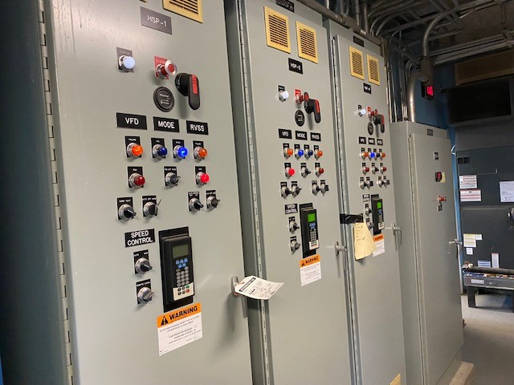
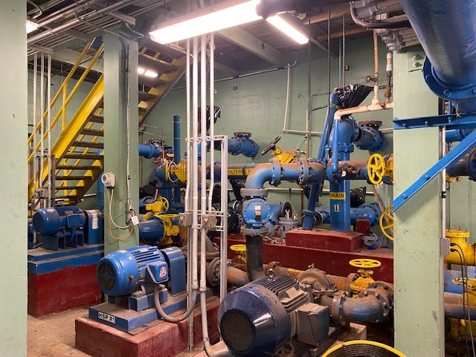
Convent Water Plant Pump Gallery

Slide 10
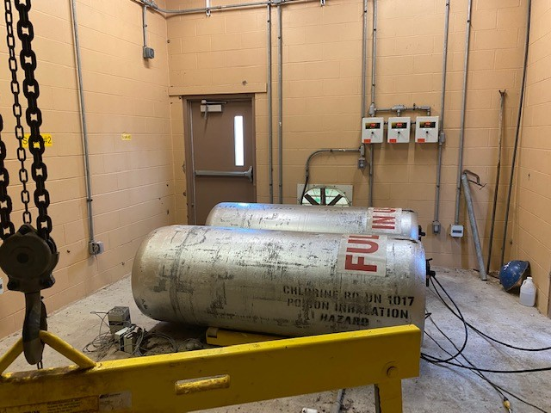
Convent Water Plant Chlorine Building
Constructed 2016

Slide 11
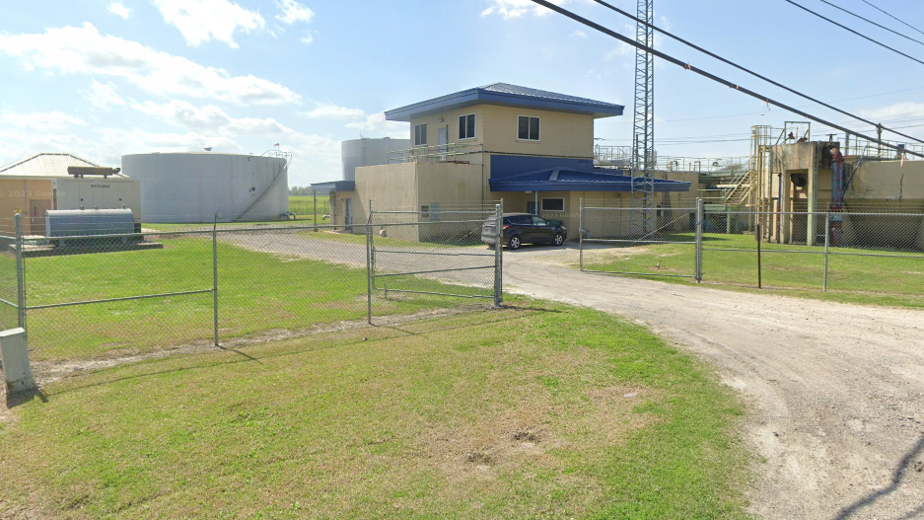
Vacherie Water Plant
Constructed in 1954

Slide 12
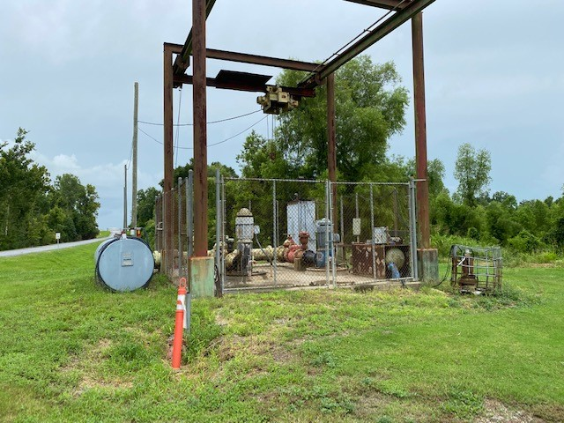
River Intake Pumps
Constructed 1983

Slide 13
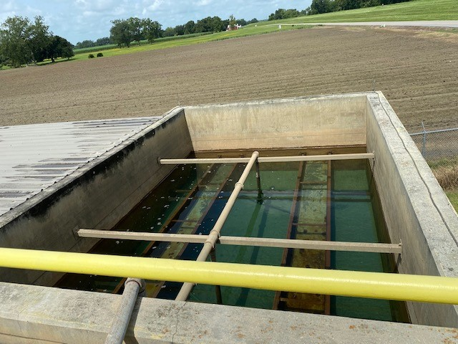
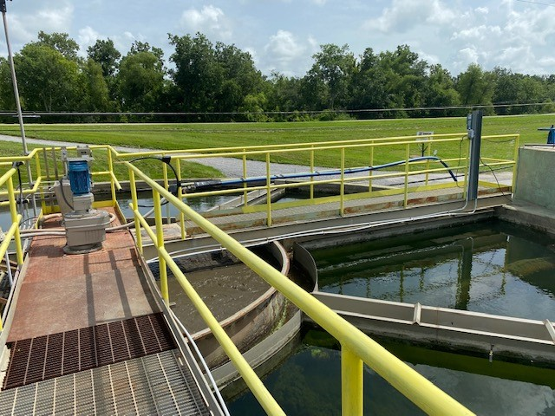
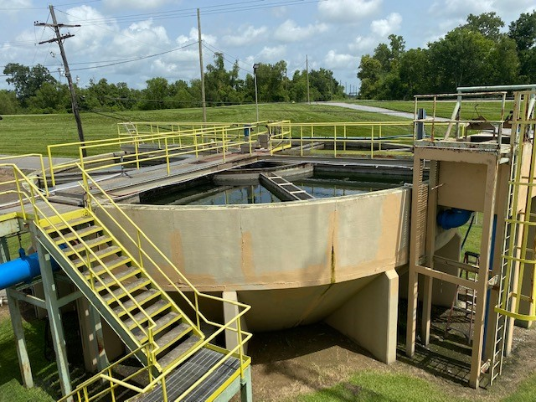
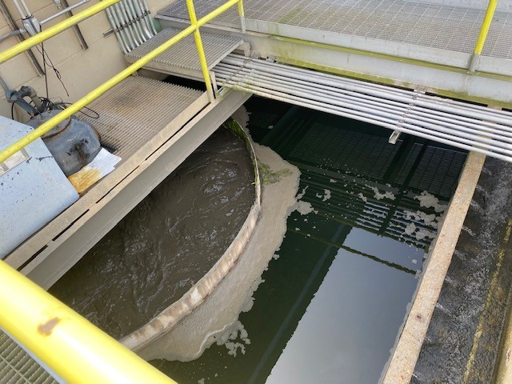
Vacherie Water Plant Clarifier & FIlters
Constructed in 1954 &1983

Slide 14
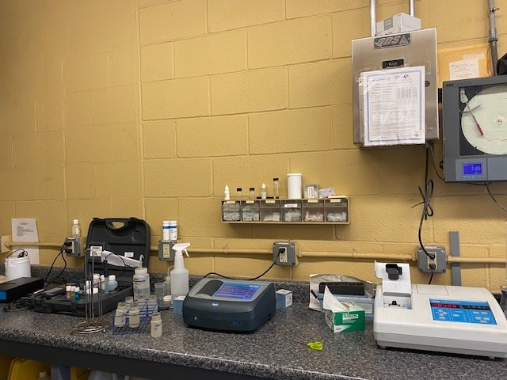
Vacherie Water Plant Lab

Slide 15
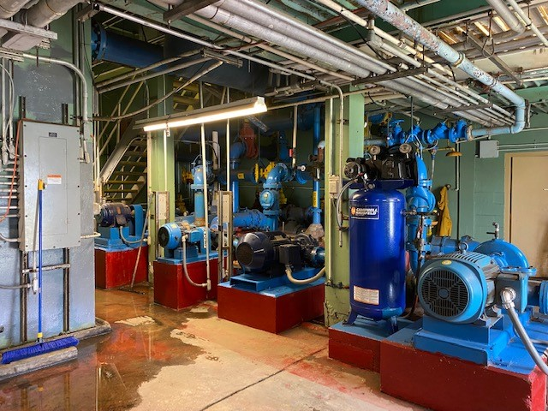
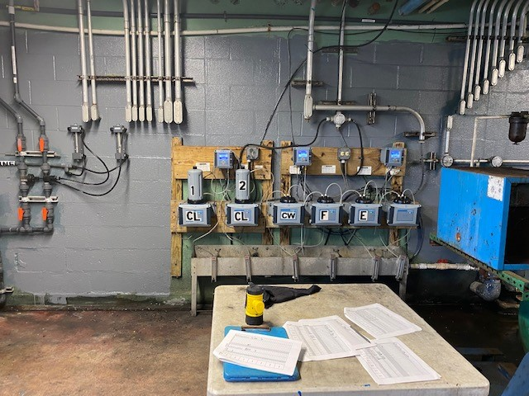
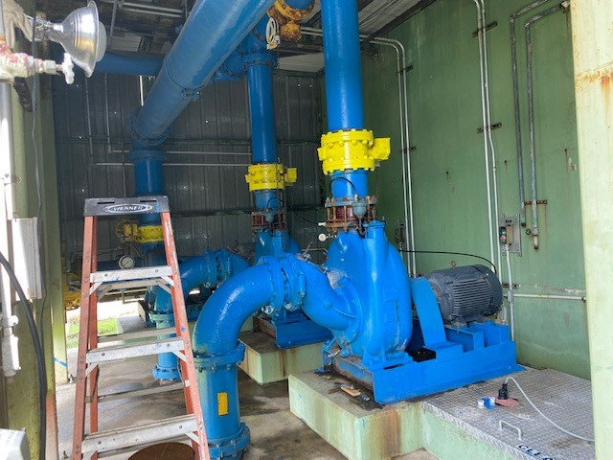
Vacheire Pipe Gallery

Slide 16
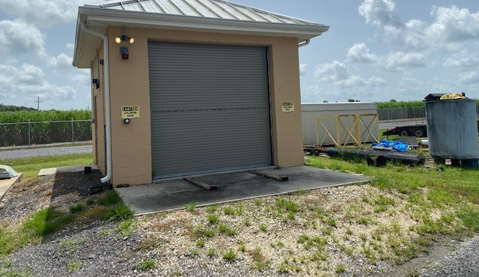
Vacherie Water Plant Chlorine Room
Constructed in 2015

Slide 17
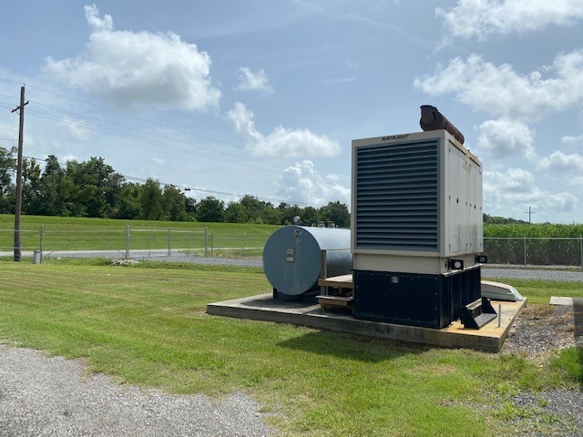
Vacherie Water Plant Generator
400 KW installed in 2010

Slide 18
ST. James Utilities Water District 1 & 2 Water Towers
St. James #1 has 2 Towers
St. James #2 has 4 Towers

Slide 19
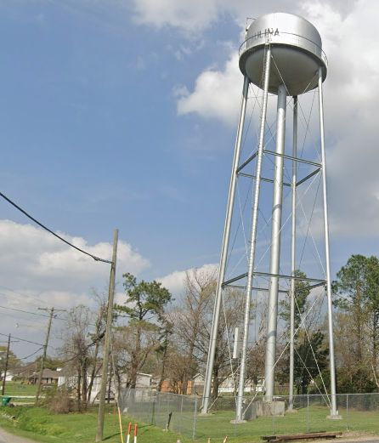
Paulina Tower
50,000 Gallons
Tank Renovation completed in 2024 for $128,000
Will cost $110,000 over next 10 years to maintain Tower

Slide 20
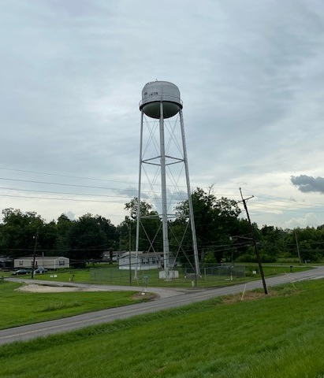
Union Tower
75,000 Gallons
Currently Under Maintenance Contract with UGS (utility service group)
Will cost $116,000 over next 10 years to maintain

Slide 21
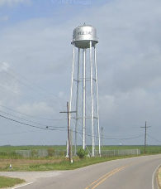
Welcome Tower
50,000 Gallons
Currently under maintenance contract with UGS (utility service group).
Will cost $114,000 over next 10 years to maintain.

Slide 22
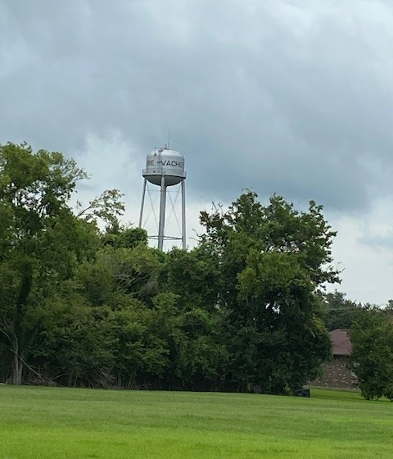
North Vacherie Water Tower
75,000 Gallons
Currently under maintenance contract with Utility Service Group (UGS)
Will cost $206,000 to maintain over next 10 years (this price does include a full renovation on year 3).

Slide 23
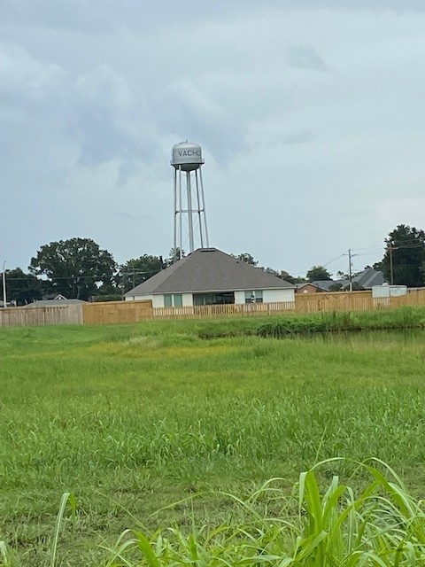
Tri-Corner Tower
50,000 Gallons
Currently under Maintenance contract with Utility Service Group
Will cost $260,000 to maintain over next 10 years with full renovation in year 4.

Slide 24
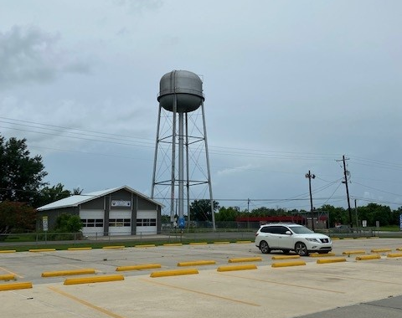
South Vacherie Tower
250,000 Gallons
Currently under maintenance contract with Utility Service Group
Will cost $269,000 to maintain over next 10 years with total renovation in year 2

Slide 25
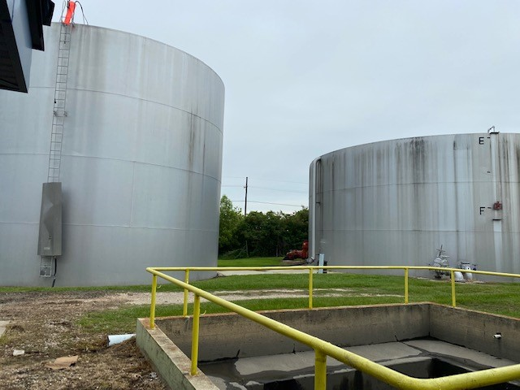
Convent Ground Storage Tanks
250,000 and 500,000 Gallons
Currently under maintenance Contract with Utility Service Group
Contract is $22,000 per year for both Tanks
Total Renovation of both tanks were done in 2010

Slide 26
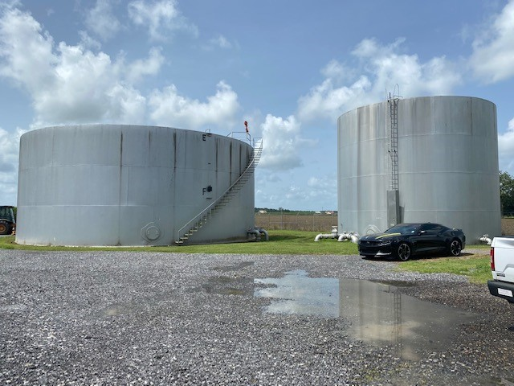
Vacherie Ground Storage Tanks
250,000 & 500,000 Gallons
Currently Under maintenance contract with Utility Service Group (UGS)
Contract is $22,000 per year for both tanks
Total renovation of both tanks were done in 2009
Planning on building additional 500,000-gallon ground storage tank

Slide 27
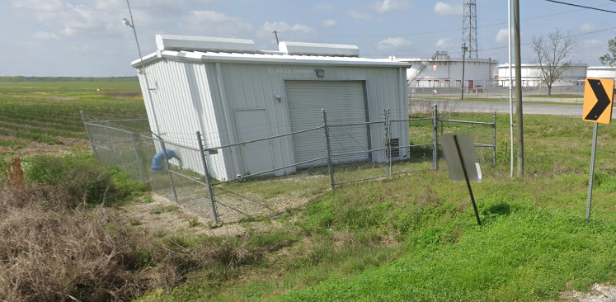
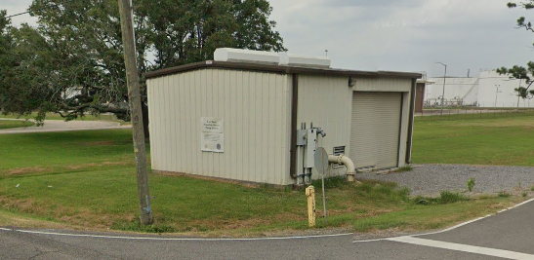
Water District 1 & 2 Booster Stations

Slide 28
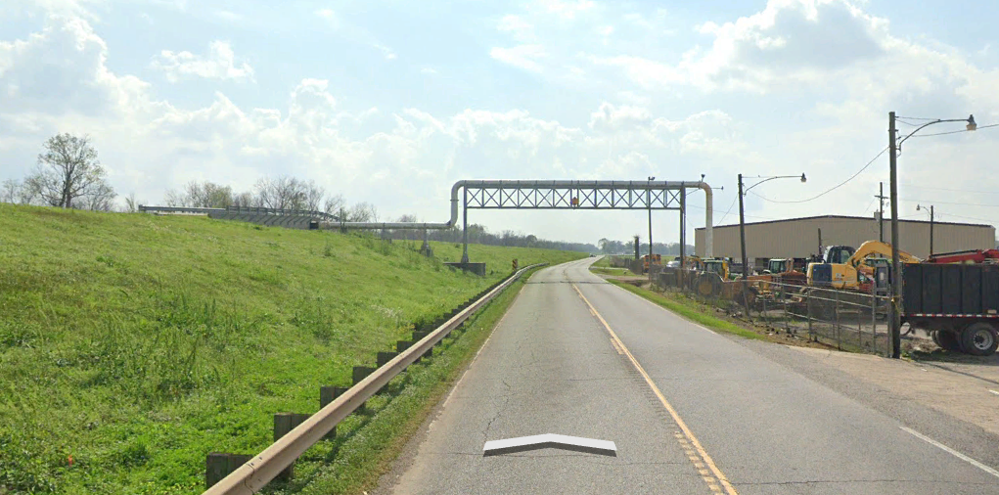
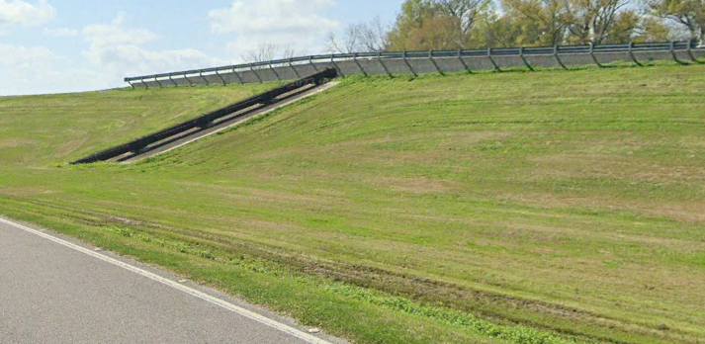
Water Line Under Mississippi River
Constructed in 2015 for $3.5 Million Dollars
1 Mile of 24” pipe
Allows both plants to be connected and aid each other in times of need

Slide 29
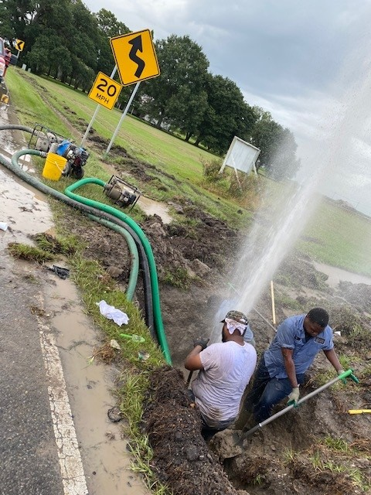
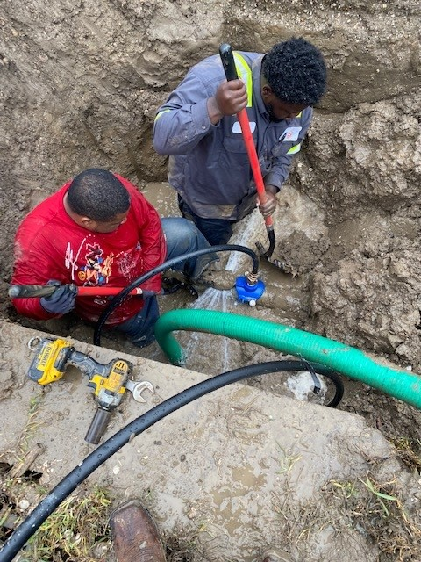
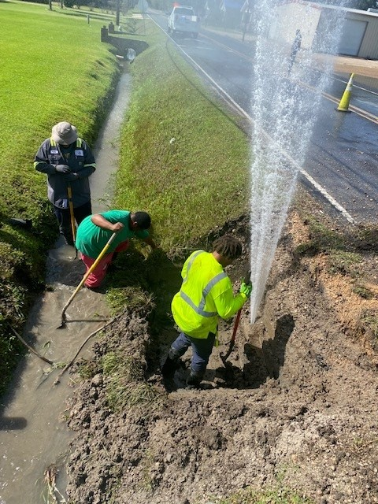
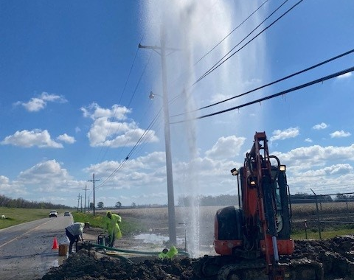
Water Lines
Over 200 Miles of Water Lines
Large water line installation projects were done in 1952 and 1976
Types of water lines in the system are A/C (asbestos concrete) and C900 PVC

Slide 30
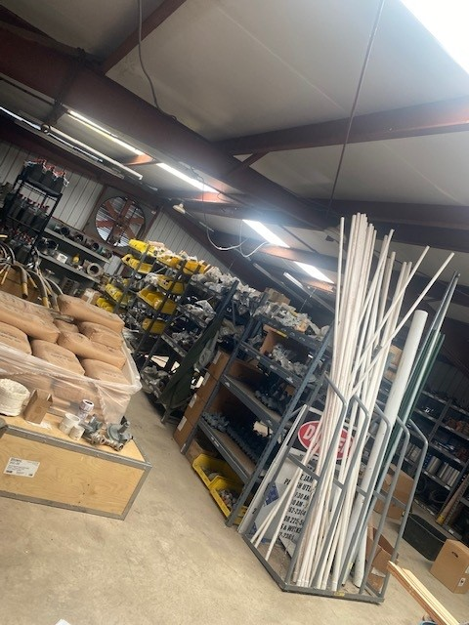
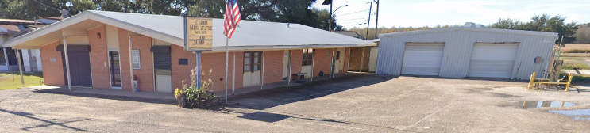
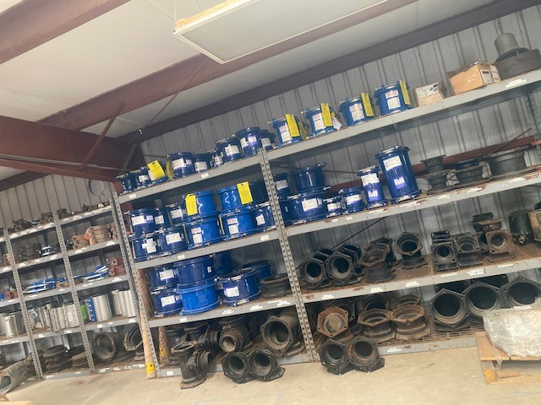
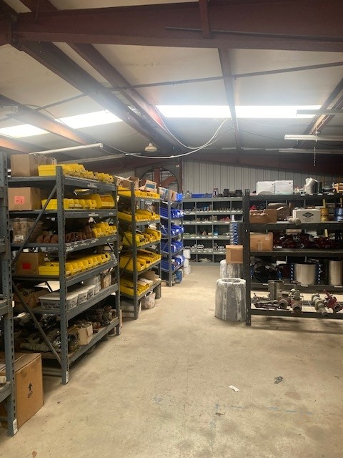
Uilities Office & Warehouse
Constructed in 1952

Slide 31

Water Meters
Roughly 7,000 water meters
Very antiquated with many moving parts (less accurate)

Slide 32

St. James Parish Natural Gas Distribution

Slide 33

Remy Gas Station
Supplies natural gas to customers along Highway 44 from Parish line to Hwy 642
Mercaptan is added
This station is supplied by Boardwalk

Slide 34

Grand Point Gas Station
Provides gas to residents along Hwy 3125 and Hwy 642 from Railroad Tracks to the end of Grand Point
This station was upgraded in 2022
This station is supplied by Boardwalk
Mercaptan is added
The 2 systems were looped in 2023

Slide 35

Vacherie Gas Station
This station supplies all customers along Hwy 18
This station is supplied by Boardwalk
Mercaptan is added

Slide 36
South Vacherie Gas Station
This station supplies gas to customers along Hwy 20 from River to South Vacherie
This station was constructed in 2023
Mercaptan is added
This station is supplied by Acadian Pipeline

Slide 37


Rectifiers
Cathodic protection uses a rectifier to convert Alternating Current (AC) power to Direct Current (DC). AC power is generally used in households and carried through power lines throughout North America. DC power is generally found in batteries like those found in your car or used in a flashlight. On one side, the rectifier output is electrically connected to the pipe, and on the other side, it is connected to anodes (metal rods). The rectifier is usually sited adjacent to existing power lines in the area. Anodes are buried in groups (referred to as ground beds) along the pipeline and are backfilled with a carbon-based conductive material to improve their effectiveness. As long as the electric current flows from the pipeline through the rectifier to the anode bed exposed pipe metal is protected from corrosion.
There are 17 rectifiers on the West Bank
There are 9 rectifiers on the East Bank
1 - 2 rectifiers are rebuilt every year at a cost of $15,000 each

Slide 38

Pipeline
Over 200 Miles of Natural Gas Pipeline (Steel and Polyethene)
Pipeline has rigorous safety inspections yearly
All operators must be qualified to work on pipeline.
Yearly cost to keep our operators certified is $20,000
Upgraded pipeline along Hwy 642 on the East Bank replacing PVC with PE, this was a major improvement allowing pressures to be raised from 21psi to 60psi.

Slide 39

St. James Parish Sewer Divsion

Slide 40



Bellvue Lakes
2 Lift Stations
Sewer gets pumped to Lutcher Sewer Pond

Slide 41

Park View Subdividion
Sewer Plant was added in 2024

Slide 42

Sugar View Subdivision
Sugarview currently has 1 lift station that gets pumped to the Molaison Sewer Plant

Slide 43



Molaison Community Sewer
2 Lift Stations
Sewer is transferred to the 24,000 gallon per day treatment plant

Slide 44

Sugar Hill Crossing
1 Lift Station
Sewer gets pumped to Donaldsonville Sewer Plant

Slide 45
All Parish Buildings and Facilities
Quarterly Discharge Monitoring Repots must be submitted to Louisiana DEQ
Adult Detention Center
Courthouse
4th District Senior Center
5th District Senior Center
7th District Senior Center (future)
3rd District Park
4th District Park
5th District Park
6th District Park
7th District Park
West Bank Maintenance Shop
Courthouse Annex
Vacherie Library
Utilities Office
Vacherie Water Plant
Convent Water Plant

Slide 46




Utilities Fleet
23 - Utility Trucks
3 - Mini Excavators
2 - Forklifts
3 - Utility Trailers
1 - 6” Deisel Trash Pump
1 - 60KW Trailer Mounted Generator
2 - Boring Air Compressors

Slide 47




Personell
Our Greatest Asset!!

