Slide 1
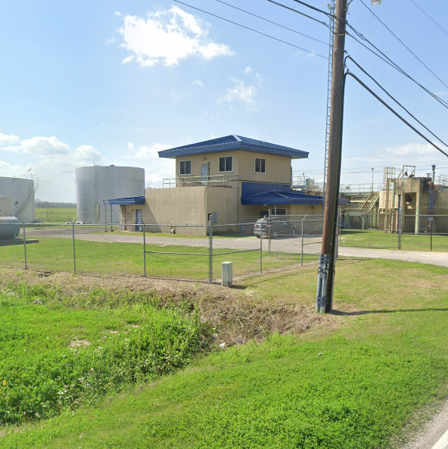
2004 – 2024 WATER PLANT OPERATIONS
ST. James #1 & 2

Slide 2
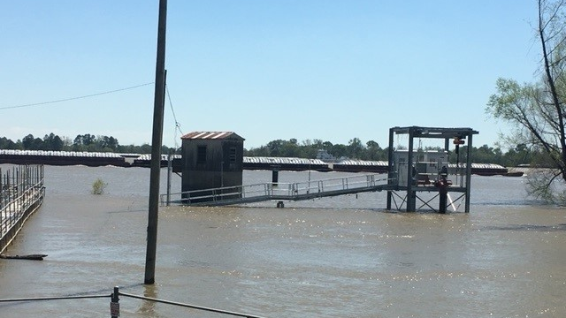
Production
St. James # 1 & 2 Pumps and Treats over 1.5 Billion Gallons of water a year

Slide 3
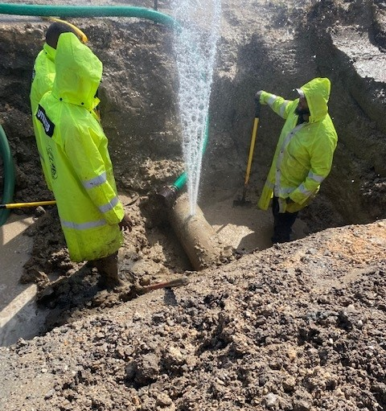
Distribution
Utilities dept. maintains over 250 miles of pipeline

Slide 4
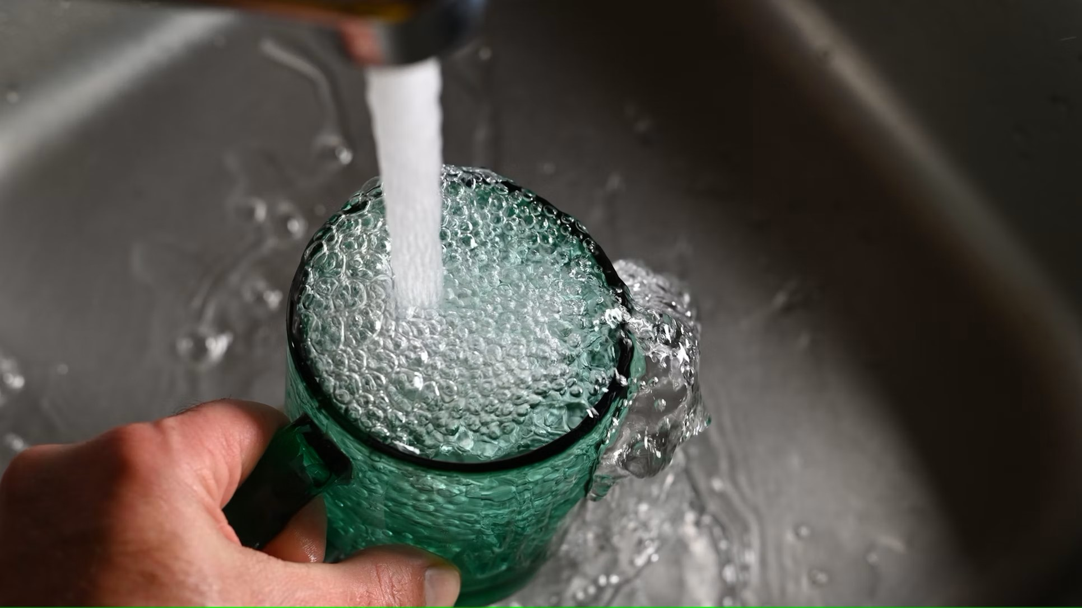
Treatment
The Utilities Dept delivers treated potable water to over 6,000 service connections

Slide 5
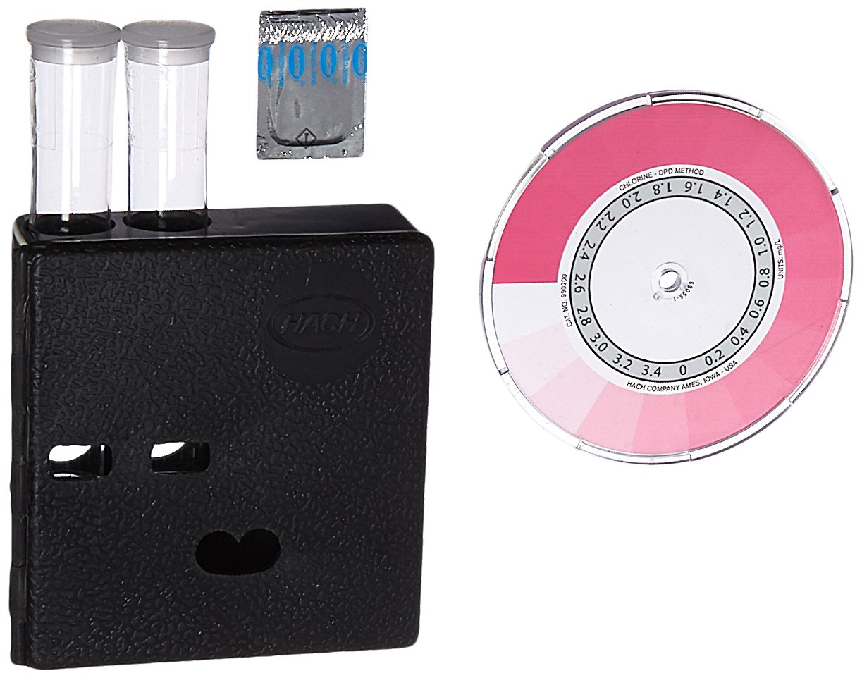
In 2004 LADHH required a trace of chlorine for our Daily Chlorine Residual at Maximum Residence Time (MRT)

Slide 6
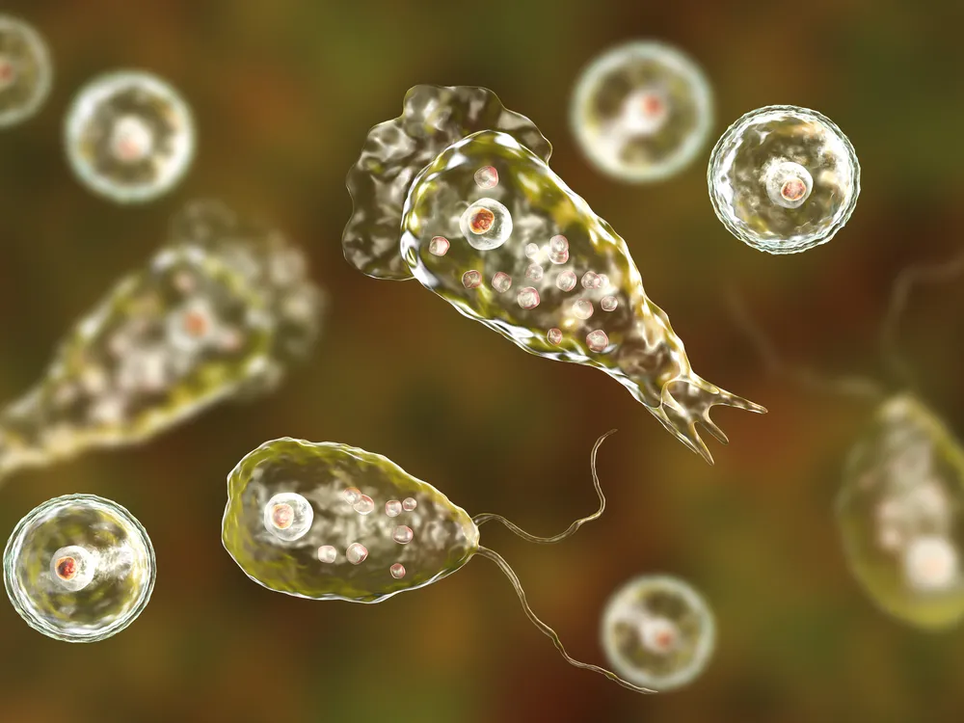
In 2013, a 4-year-old in St. Bernard Parish died from the brain-eating amoeba (Naegleria fowleri). This prompted DHH to implement major water treatment changes to prevent future occurrences.

Slide 7

In November of 2013 LADHH issued an Emergency rule requiring drinking water systems in Louisiana to raise the level of disinfectant in their water, and increase monitoring by 25 percent
This Required going from a trace of Chlorine at MRT to a 0.5ppm

Slide 8
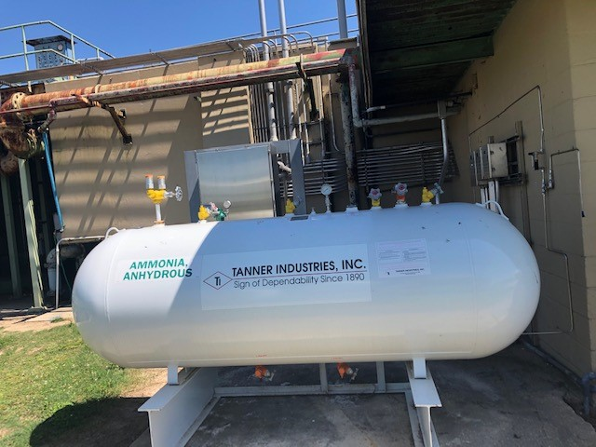
In early 2014, St. James transitioned from a free chlorine system to a chloramine system. This change involved introducing ammonia into the Clearwell, where it reacted with chlorine, allowing the residual to travel further.

Slide 9
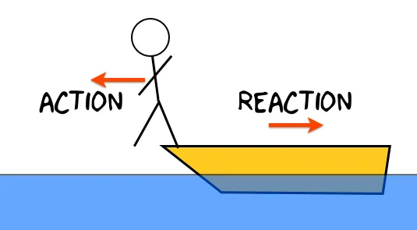
As Newton Stated for every action there is an equal and opposite reaction.
When chlorine reacts with naturally occurring organic substances in drinking water Trihalomethanes are formed

Slide 10
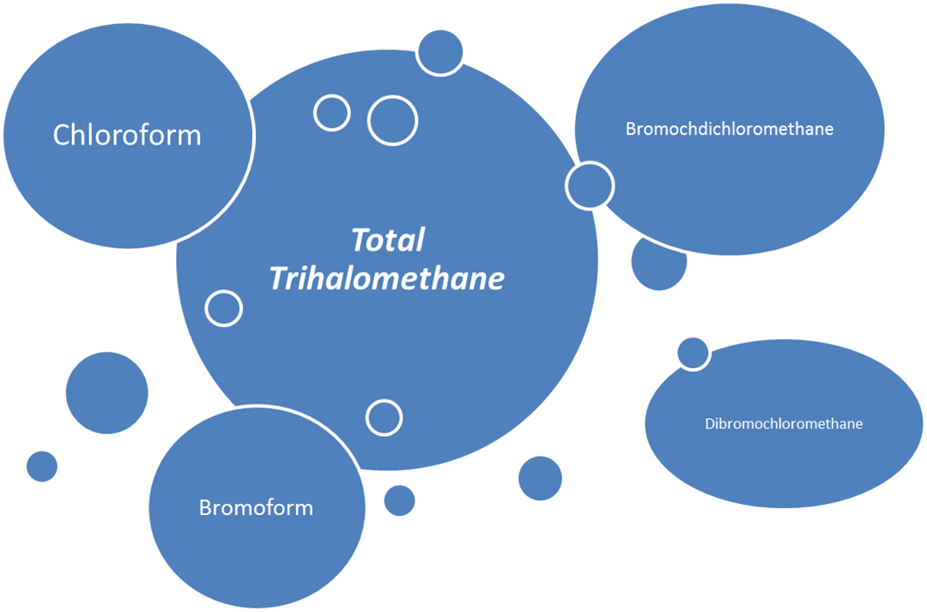
What are Trihalomethanes?
Trihalomethanes are volatile organic compounds which include a group of four chemical compounds that are formed along with other disinfection by-products when chlorine or other disinfectants used to control microbial contaminants in drinking water react with naturally occurring organic (humic substances) and inorganic matter in water. The 4 compounds that make up trihalomethanes are: Chloroform, bromodichloromethane, dibrocloromethane, and bromoform.

Slide 11
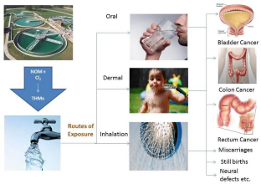
What are the Health Risk of Trihalomethanes?
Some people who drink water containing trihalomethanes in excess of the MCL over many years may experience problems with there liver, kidneys, or central nervous systems, and may have an increased risk of getting cancer.

Slide 12
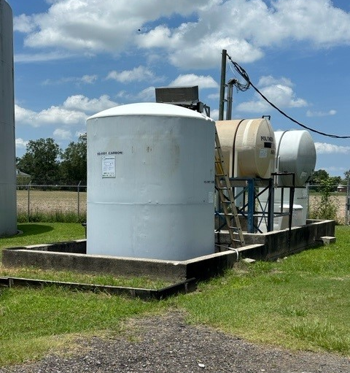
What is St. James Utilities doing to combat excess Trihalomethanes?
In 2016 along with St. Charles Parish, St. James Utilities department entered into a trial of the Activated Carbon Product KS-9001

Slide 13
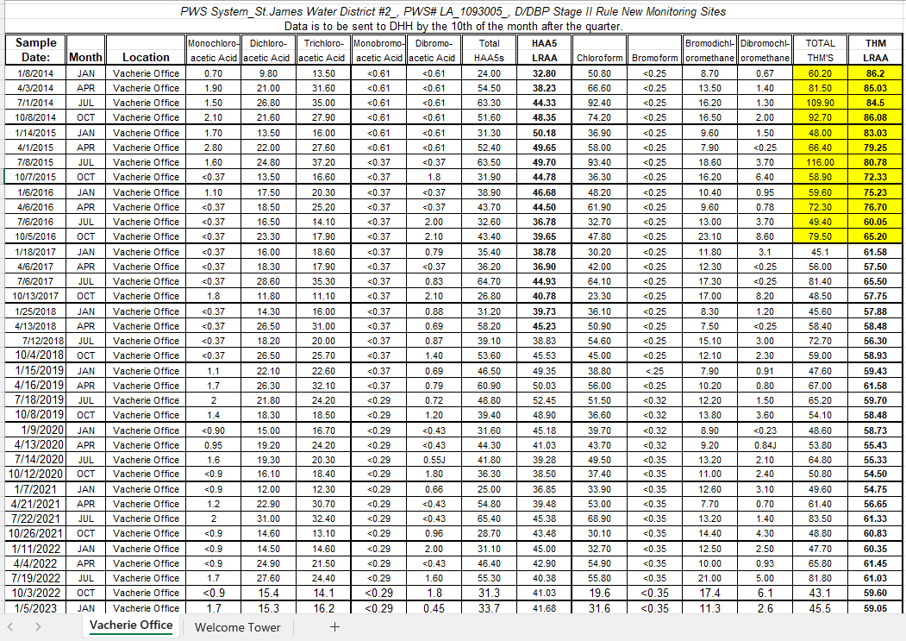
What have been the results of feeding KS-9001
The TTHM was drastically reduced, as you can see. An average above 80 would be a violation with public notice

Slide 14

Great Results come with a Price!
We spend over $350,000 annually on KS-9001

Slide 15
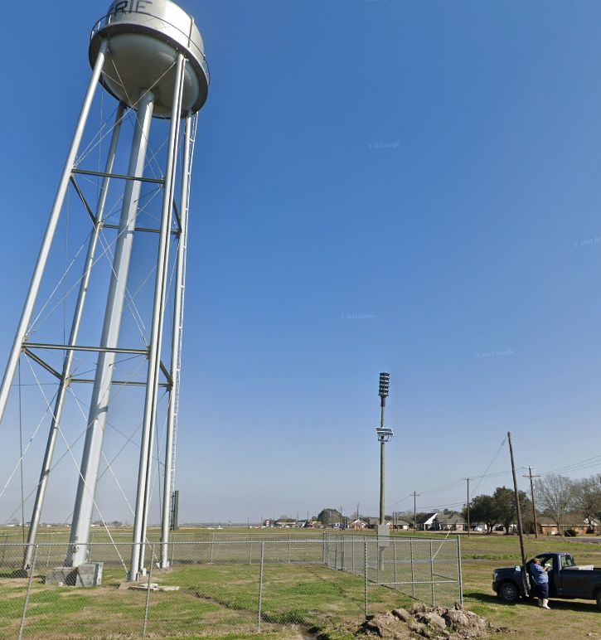
At this time, we also implemented the Water Quality Technician position. This person collects daily chlorine residual samples and performs any necessary flushing to maintain a healthy chlorine residual throughout the parish. We currently have two technicians: one on the East Bank and one on the West Bank. This person also serves as a relief water plant operator.

Slide 16
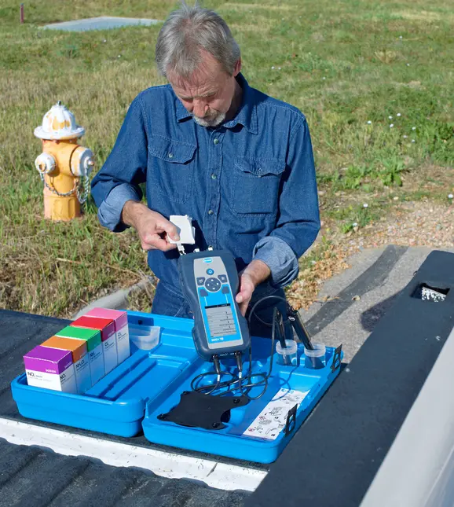
Our Water Quality Techs currently use the HACH SL1000 portable parallel Analyzer. Which has a life span of 3-5 years.
The current price of this analyzer is $5,200

Slide 17
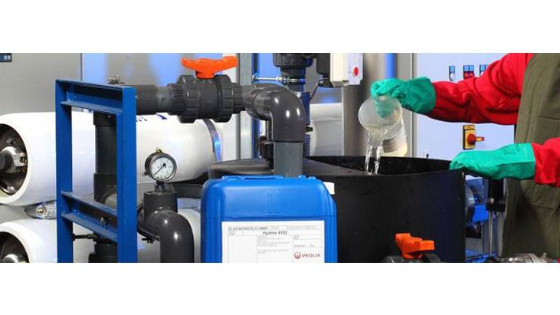
Current Chemicals Used

Slide 18
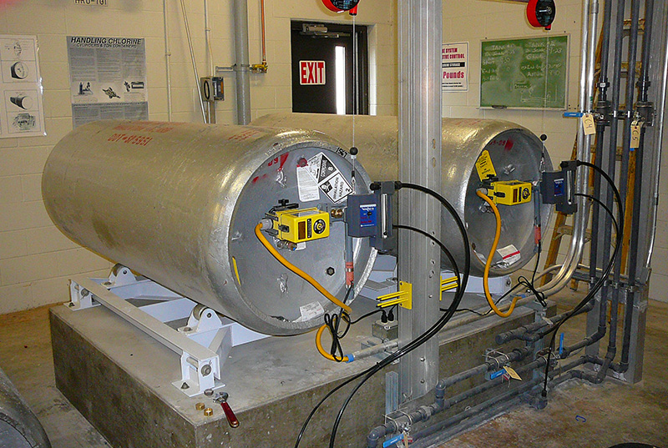
CHLORINE
Due to its high toxicity, chlorine can effectively kill disease-causing bacteria in public drinking water. Chlorine is an ideal sanitizer and prevents much waterborne illness and disease every day.
We spend $80,000 annually on Chlorine which is a 135% increase from 2020

Slide 19
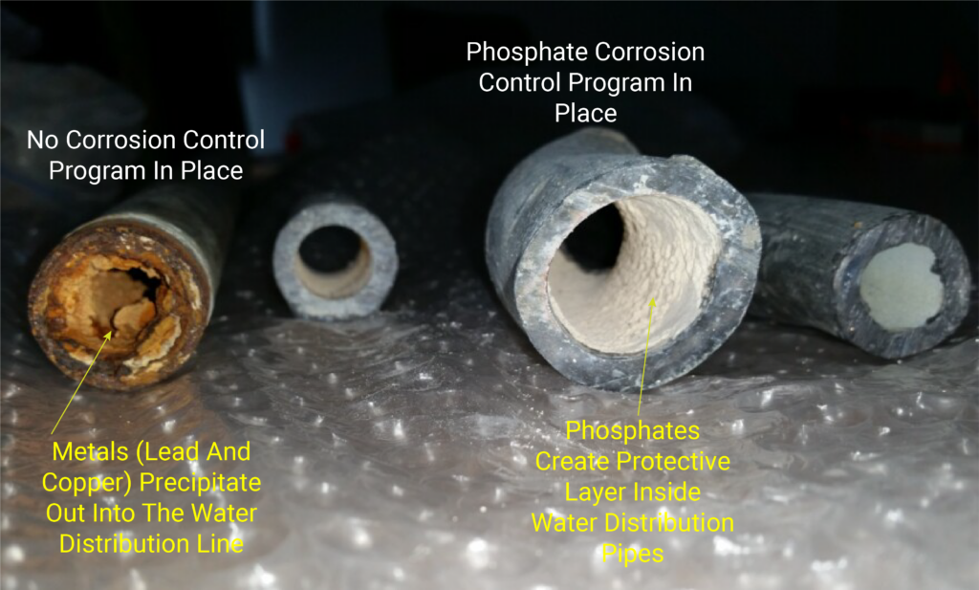
KS – 9200
Chlorine extender product boosts the pH and reduces corrosion in drinking water.
We spend $96,000 annually on this product

Slide 20
Anhydrous Ammonia
Ammonia is added to chlorine to treat drinking water to form Chloramines. Ammonia provides longer-lasting disinfection as the water moves through pipes to consumers
We spend $30,000 annually on Ammonia.

Slide 21
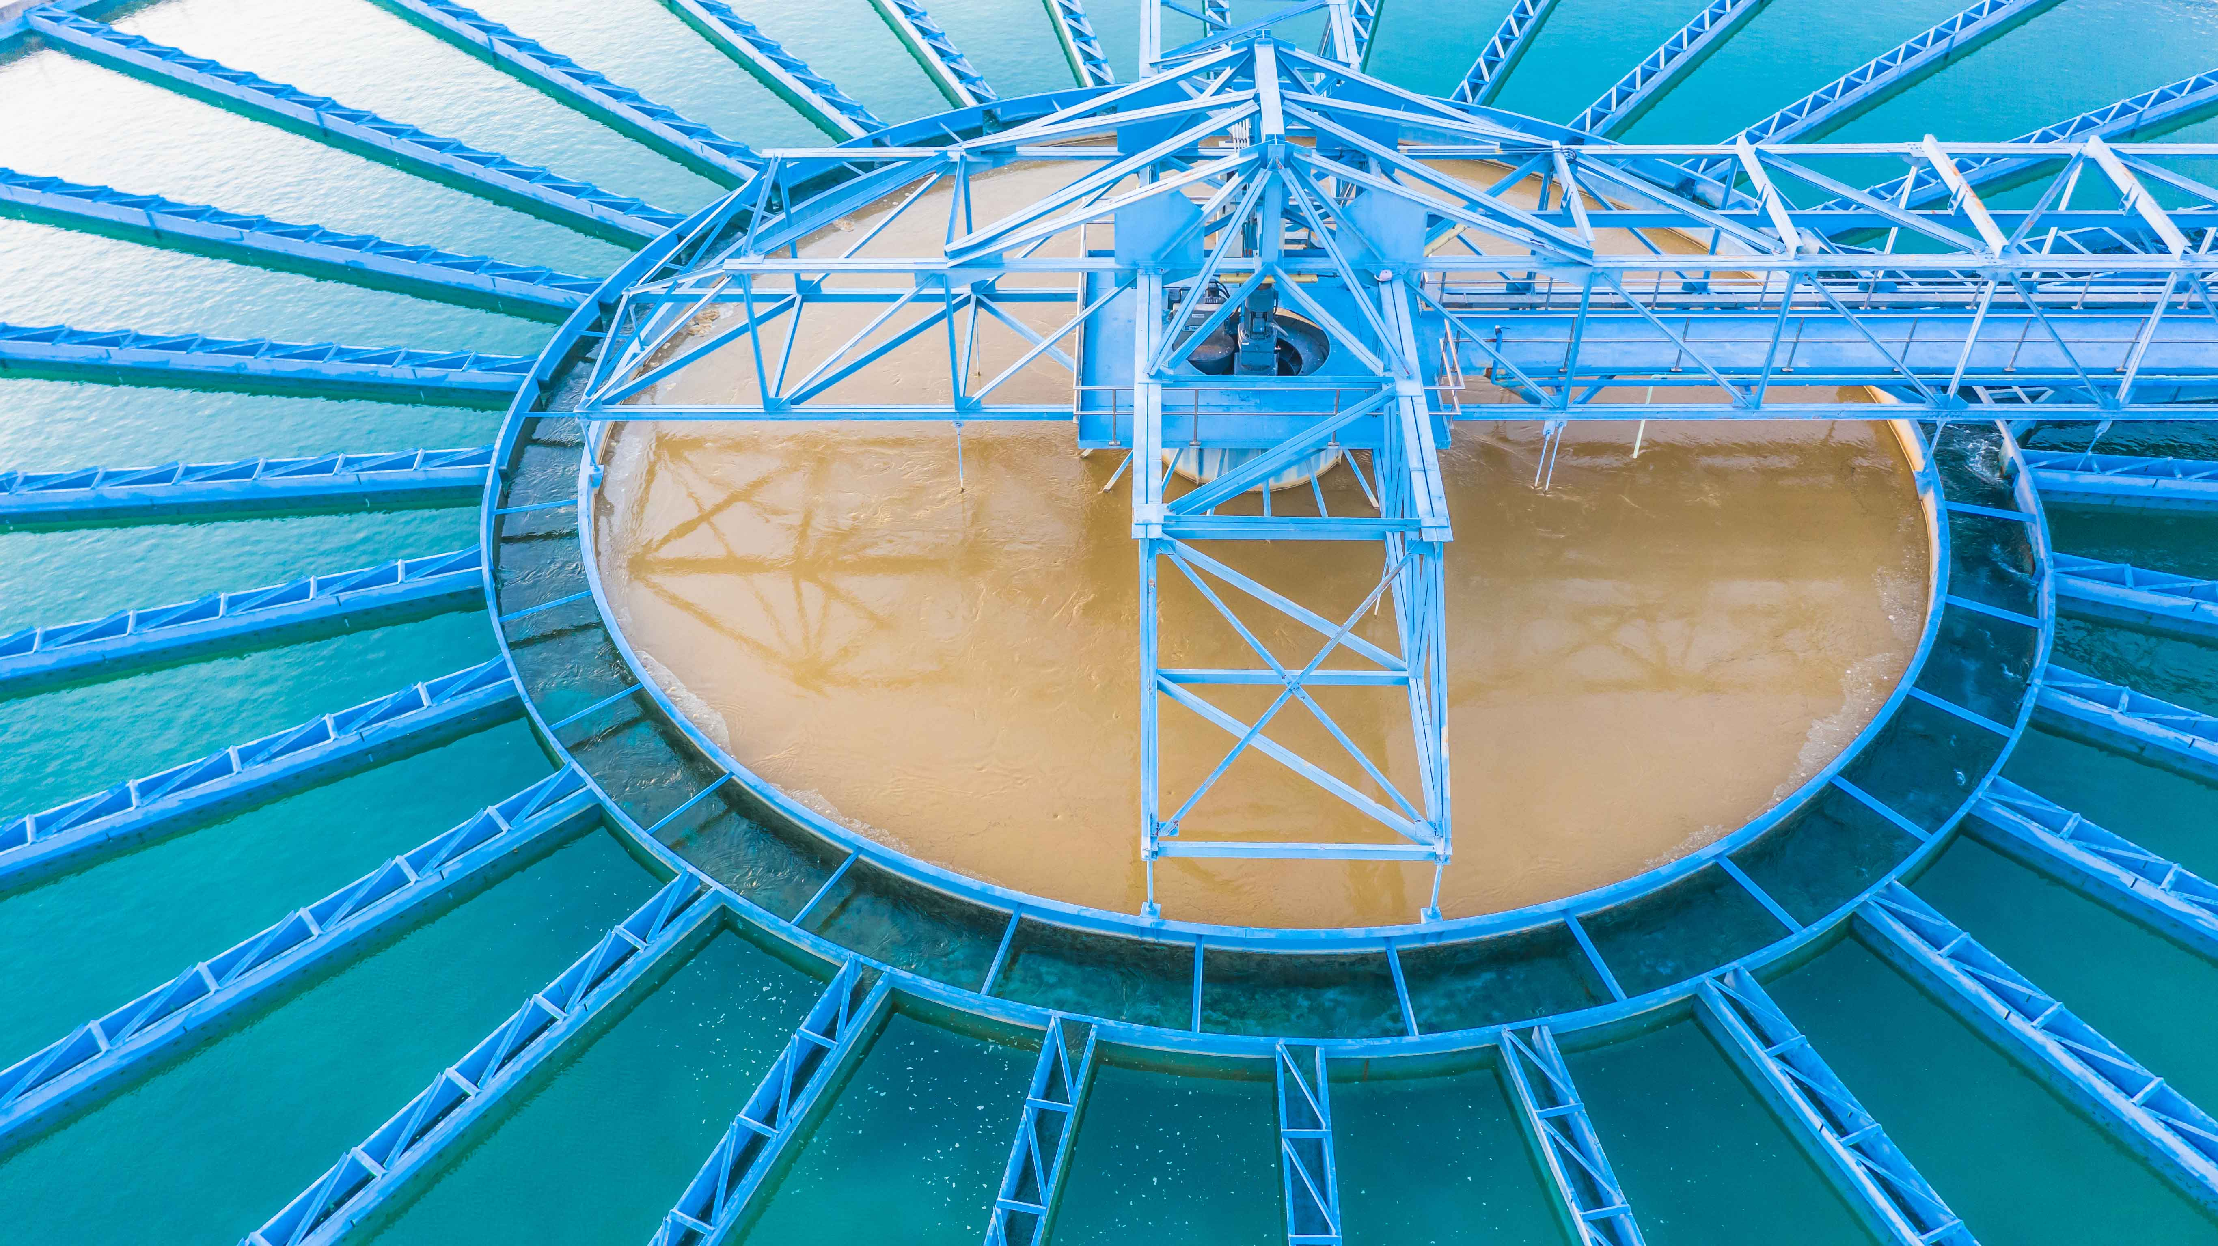
KS-1001 Polymer
Polymer is used to remove silt and mud in the clarification treatment process.
We spend $53,000 Annually on Polymer

Slide 22
Chemical Prices Over Last 10 Years
2014 - $123,818.00 2019 - $238,732.00
2015 - $148,777.00 2020 - $271,320.00
2016 - $189,756.00 2021 - $303,683.00
2017 - $142,901.00 2022 - $441,009.00
2018 - $182,826.00 2023 - $552,858.00
347% Increase !!!

Slide 23

New Chalenges we are facing

Slide 24
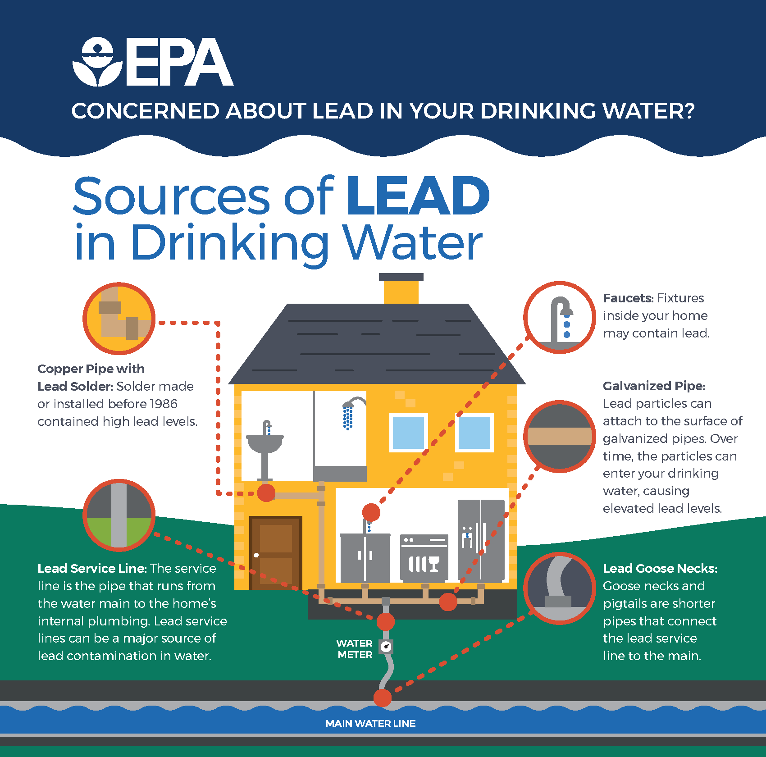
LEAD AND COPPER RULE:
On December 16, 2021, the U.S. Environmental Protection Agency (EPA) announced that the Lead and Copper Rule Revisions (LCRR) issued January 15, 2021 will go into effect to support near term actions to reduce lead in drinking water. The LCRR establishes a compliance deadline of October 16, 2024 for water systems to complete their initial service line inventories. In addition, EPA announced that they will begin developing new regulation, Lead and Copper Rule Improvements (LCRI), to strengthen key elements of the LCRR.

Slide 25
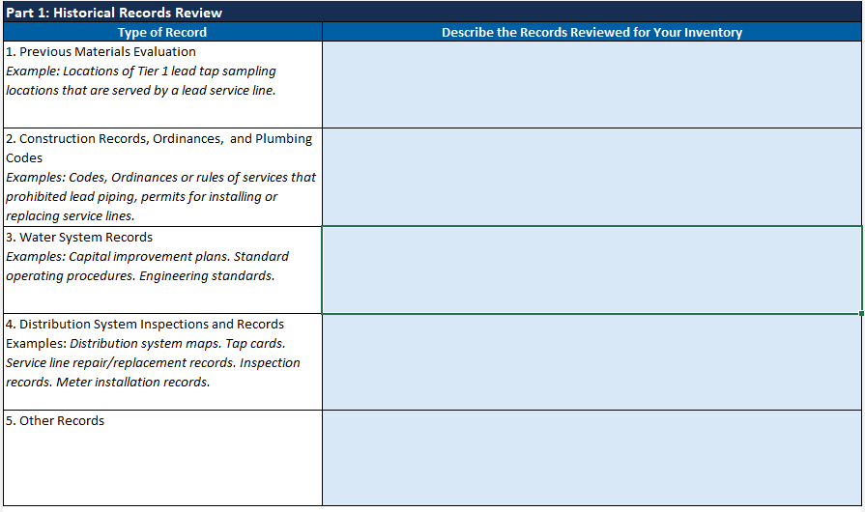
Lead & Copper Monitoring Part 1:
Historical Records Review

Slide 26
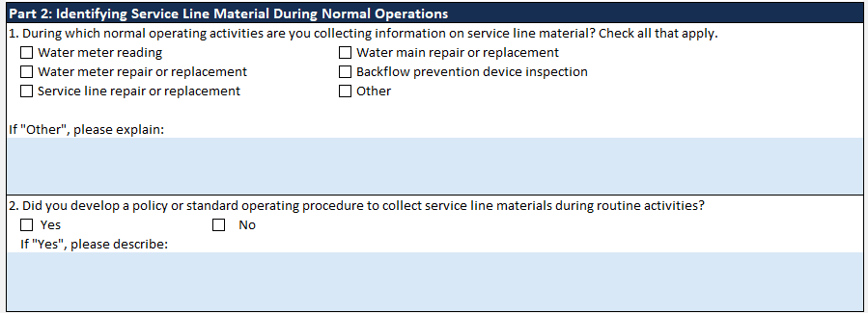
Lead and Copper Monitoring Part 2:
Identifying Service Line Material During Normal Operations

Slide 27
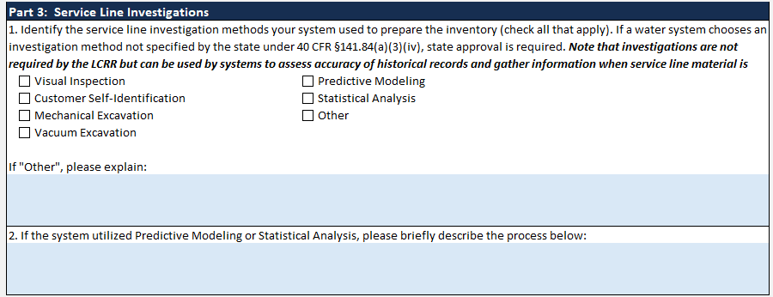
Lead & Copper Monitoring Part 3:
Service Line Investigations

Slide 28
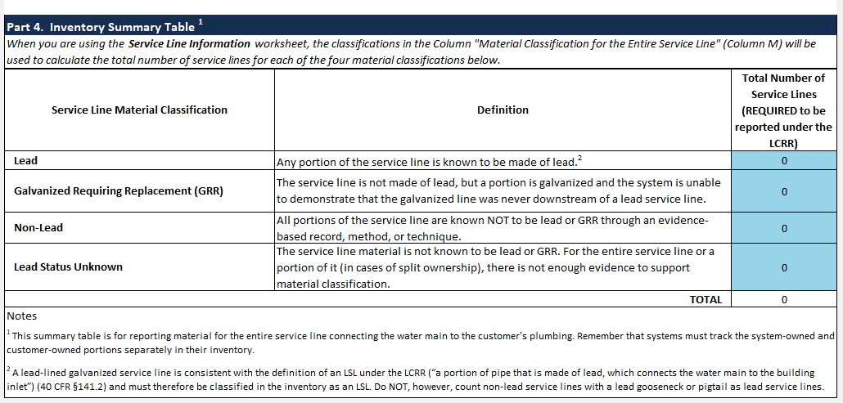
Lead & Copper Monotoring Part 4:
Inventory Summary Table

Slide 29
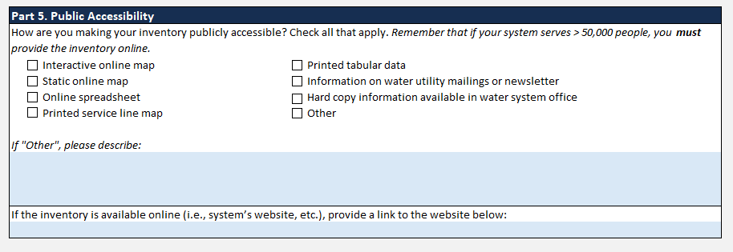
Lead and Copper Monotoring Part 5:
Public Accessiblity

Slide 30
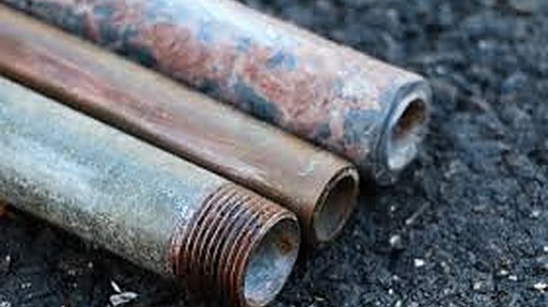
St. James Parish Council entered into a contract with OLS Dataware to consult and develop a program to manage and create our Lead and Copper Inventory. So far we have spent $30,000 to build the program and provide LADHH any and all documentation needed per milestone dates

Slide 31
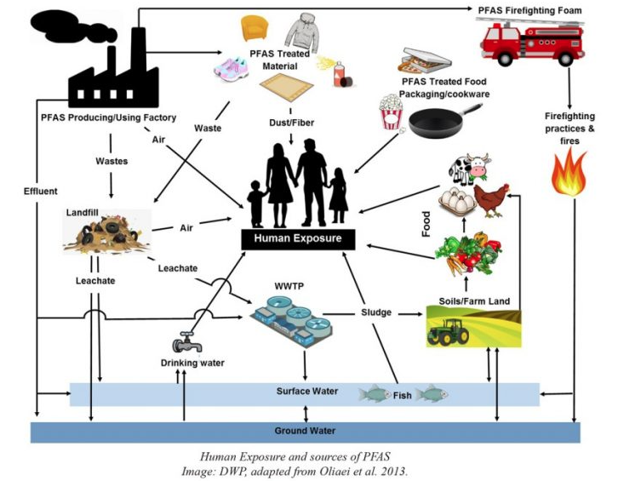
PFAS
Per- and Polyfluoroalkyl Substances (PFAS) Forever Chemicals:PFAS are a group of man-made chemicals that includes Perfluorooctanoic acid(PFOA), Perfluorooctane sulfonic acid (PFOS), Hexafluoropropylene oxide dimer acid (HFPO-DA/GenX), Perfluorobutane sulfonic acid (PFBS), Perfluorononanoic acid acid (PFNA) and Perfluorohexane sulfonic acid (PFHxS) as well as many other chemicals. PFAS have been manufactured and used in a variety of industries around the globe, including in the United States since the 1940s. There is evidence that exposure to PFAS can lead to adverse human health effects.

Slide 32
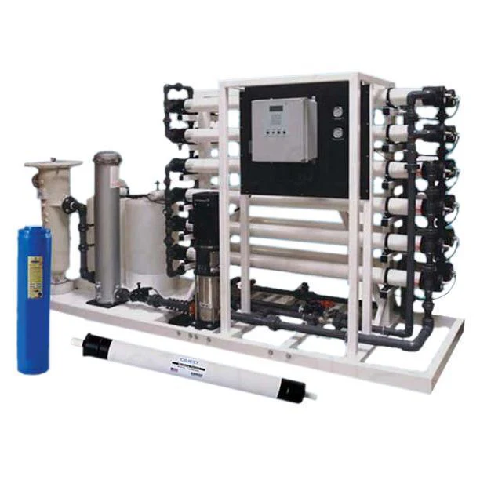
Early indications suggest that approved methods for PFAS removal will include activated carbon mitigation (which we are currently employing with KS-9001) or reverse osmosis (RO)

Slide 33
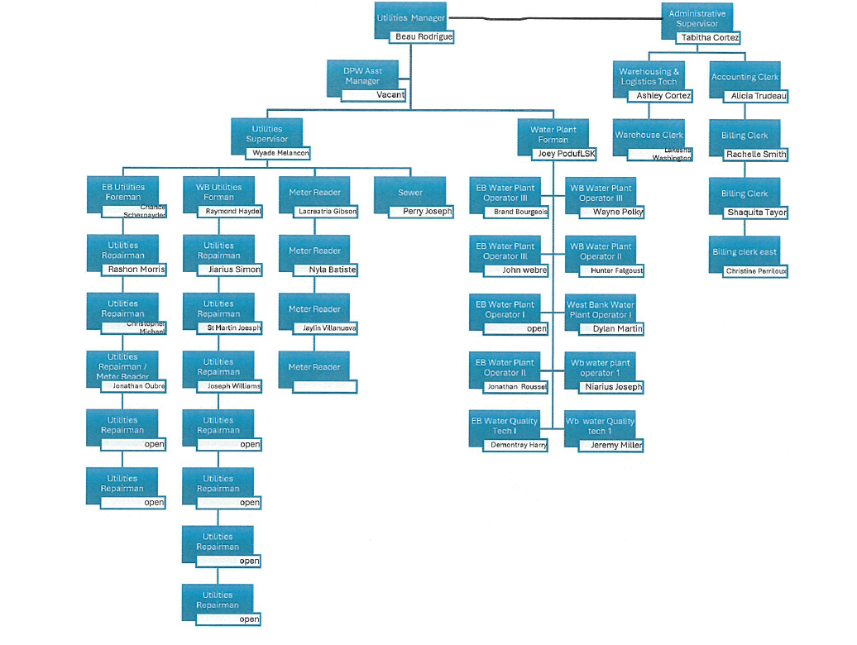
Work Force:
Utilities is currently staffed by 31 people, this is considered short staffed by approximately 10 people
Average Salary is $32,000

Slide 34

THE END

